Slide 1
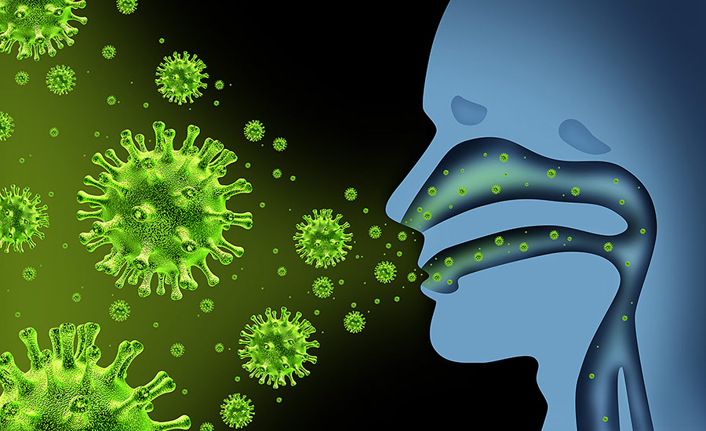
Communicable Disease

Slide 2
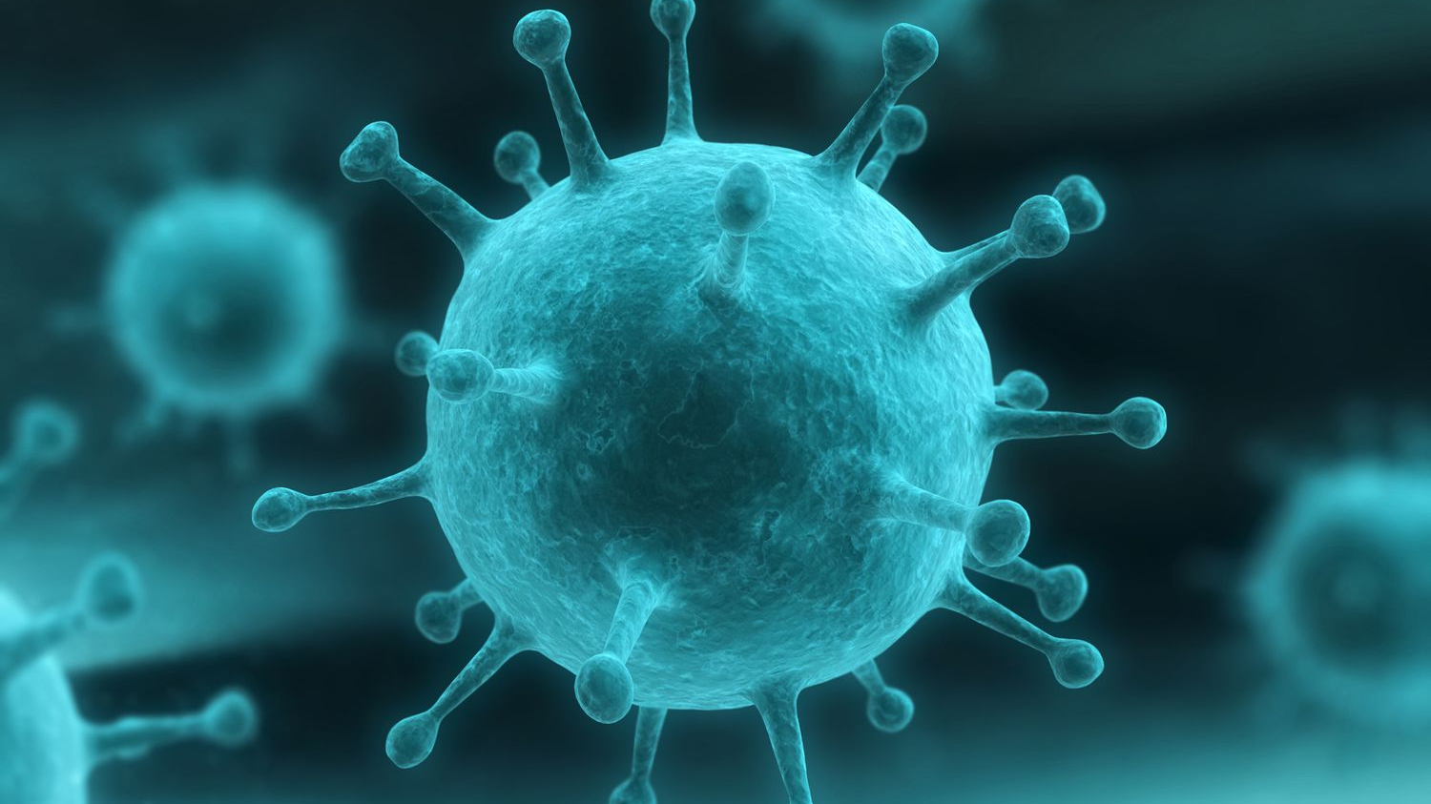
COMMUNICABLE DISEASE any illness that you can “catch” or can be passed from one person to another.

Slide 3
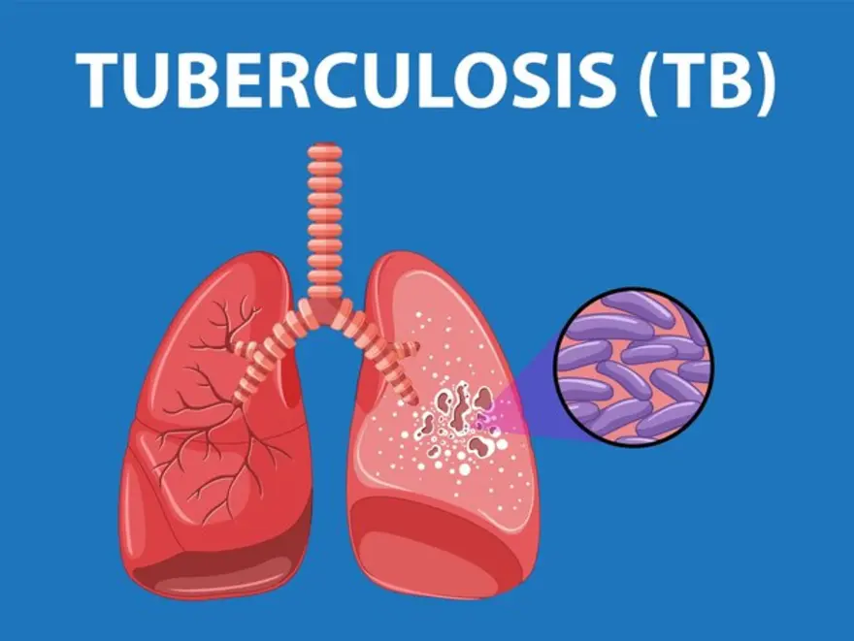

Slide 4

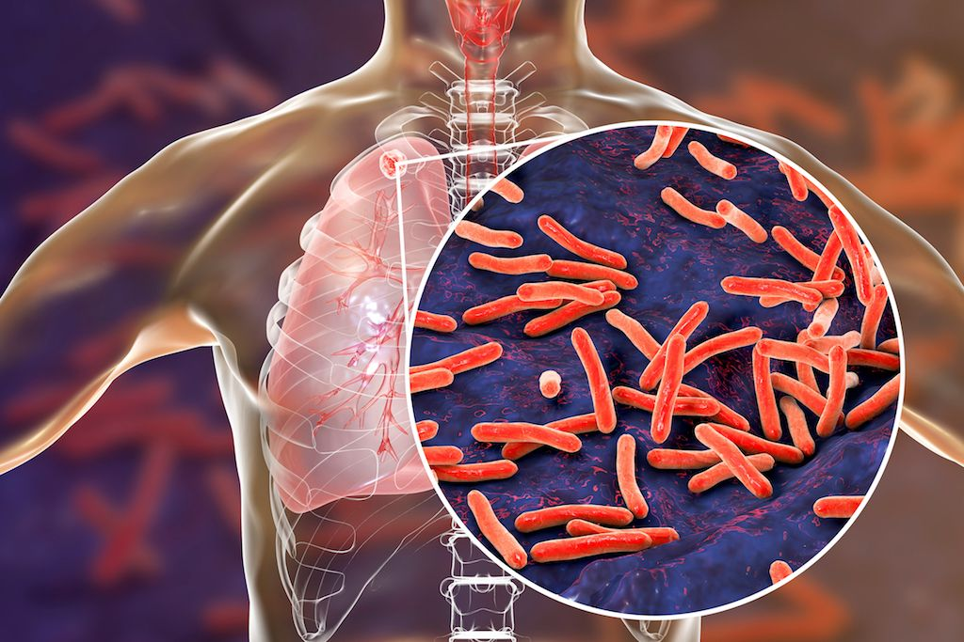
TUBERCOLOSIS
an infectious bacterial disease that commonly affects the lungs
Cough that is worse in the morning and lasts 3 weeks or longer (sometimes with blood in the sputum), chest pain, breathlessness, night sweats, signs of pneumonia, weight loss, weakness or fatigue

Slide 5
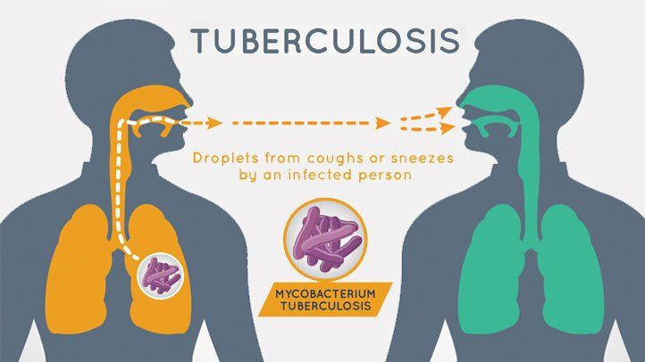

Slide 6
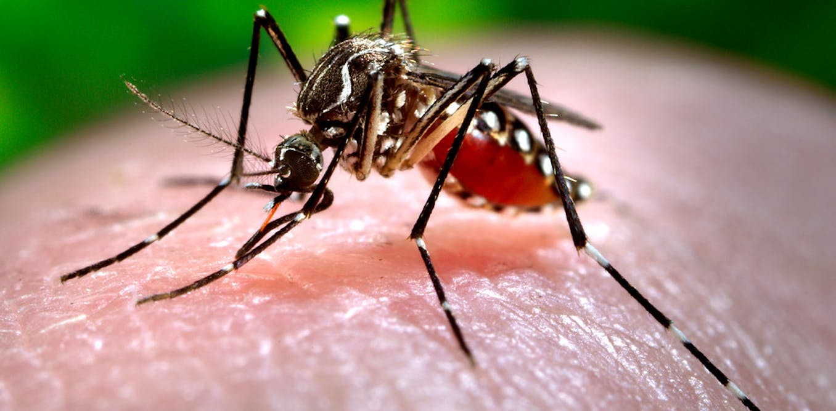
DENGUE
is a mosquito-borne disease mostly occurring in tropical and sub-tropical areas
Fever up to 41⁰C, headaches, muscle, bones, and joint pain, pain behind your eyes, widespread rash, nausea and vomiting, minor bleeding from your gums or nose

Slide 7
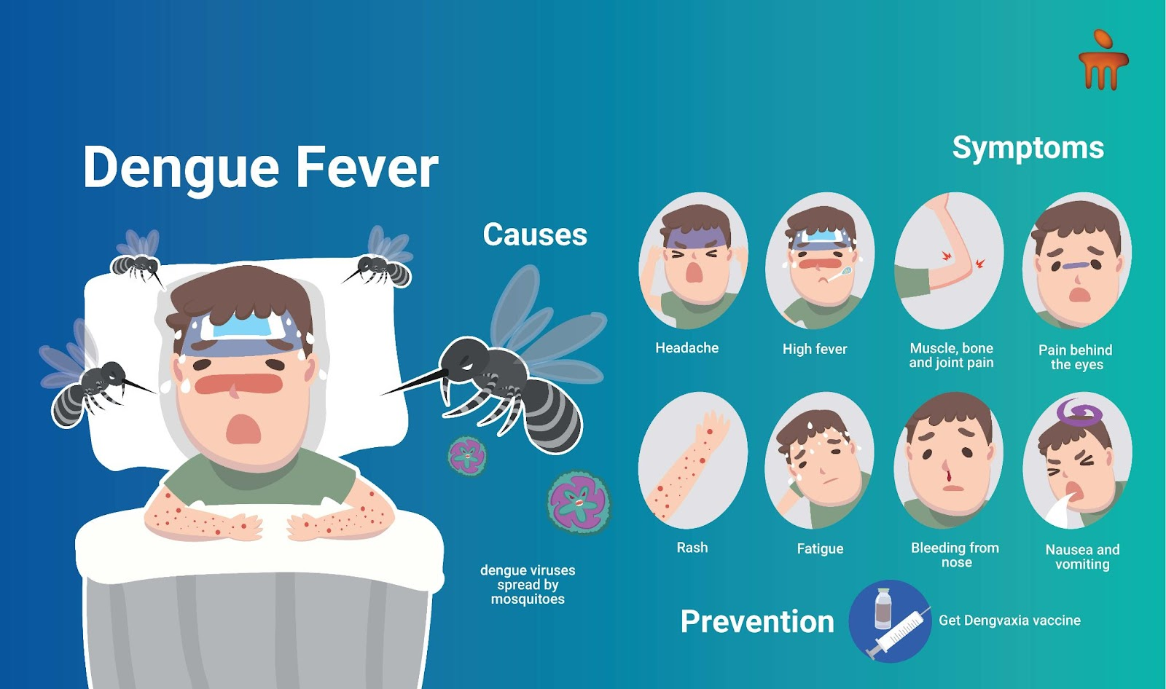

Slide 8

HIV & AIDS
AIDS is a chronic, life-threatening condition caused by HIV. HIV weakens the immune system by destroying important cells that fight diseases and infections.

Slide 9
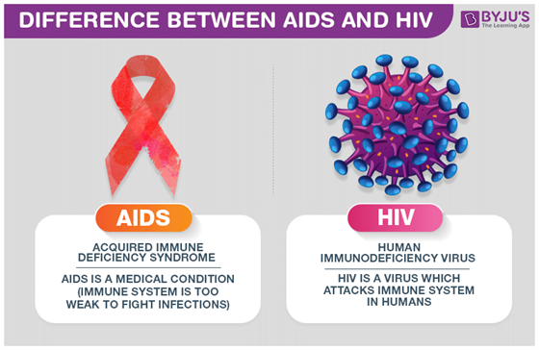

Slide 10
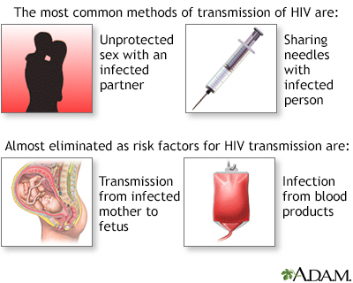

Slide 11


Slide 12

STIs - Infections that can be acquired predominantly through unprotected sexual contact.

Slide 13
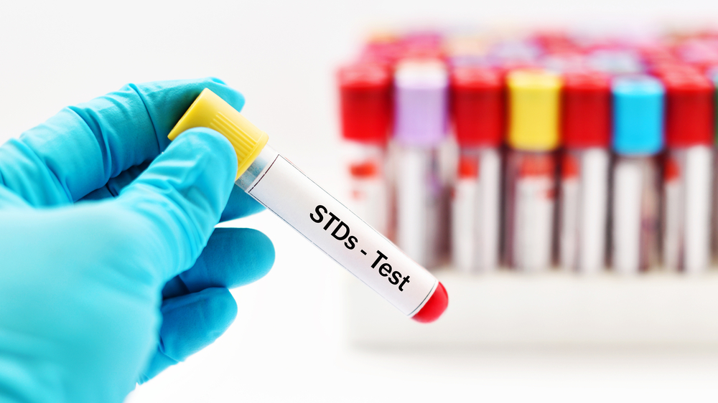
Examples are chlamydia, gonorrhea, syphilis, and herpes

Slide 14
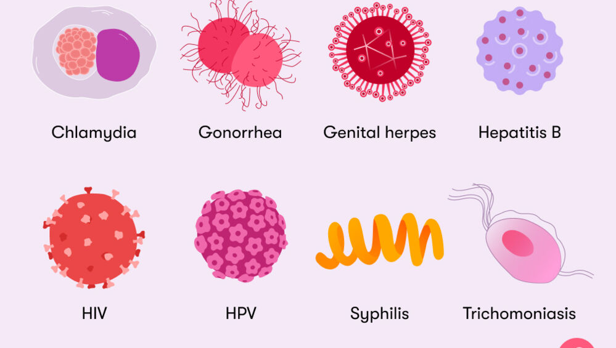

Slide 15
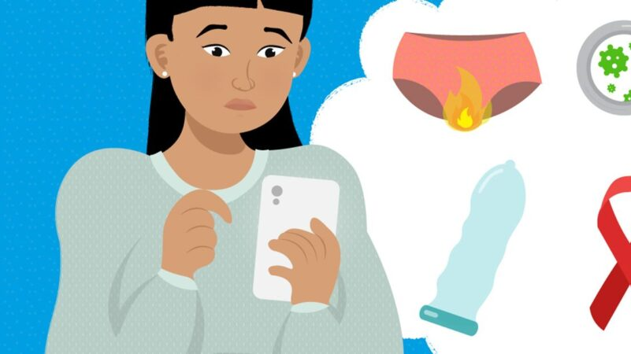
Unusual discharge from the penis, vagina, or anus; pain during sex or urination; sores, blisters, ulcers, warts or rashes in the genital areas; fever or flu-like symptoms; abnormal or unusual vaginal bleeding; pain in the scrotum or testicles; lumps and bumps on the genitals

Slide 16

Emerging and Re-Emerging Infectious Diseases (EIDs)
are infections that have newly appeared in a population or have existed previously but are rapidly increasing in incidence or geographic range

Slide 17
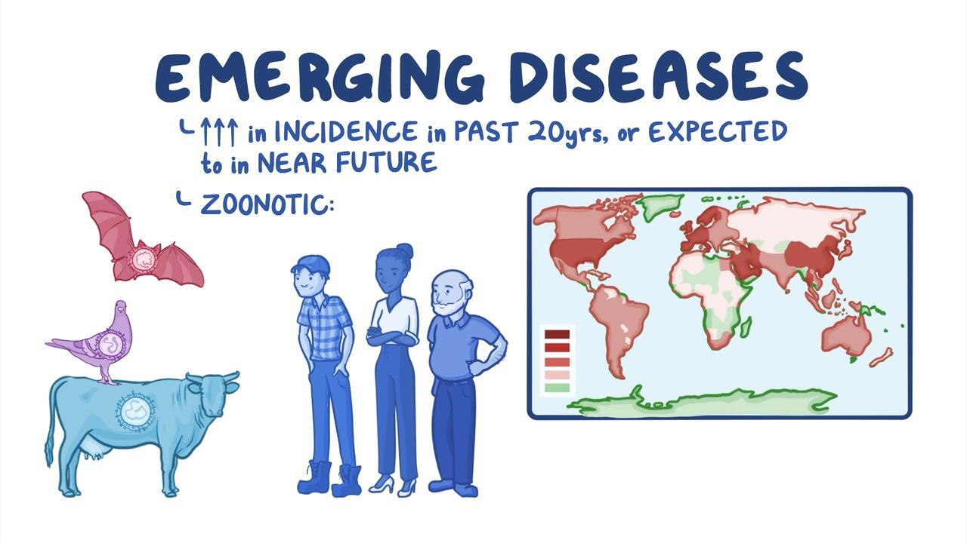

Slide 18
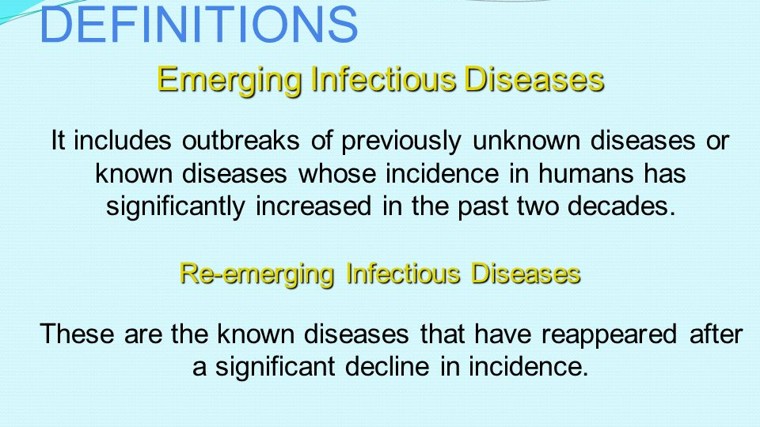

Slide 19


Slide 20
AH1N1 Influenza
a highly contagious flu caused by H1N1 virus
also called the swine flu because it is thought to originate from pigs

Slide 21
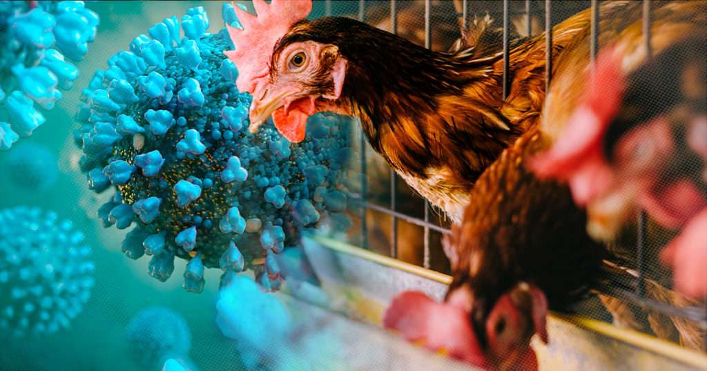

Slide 22
Avian Influenza
also known as bird flu
caused by viruses infecting birds, the H5N1 strain virus

Slide 23
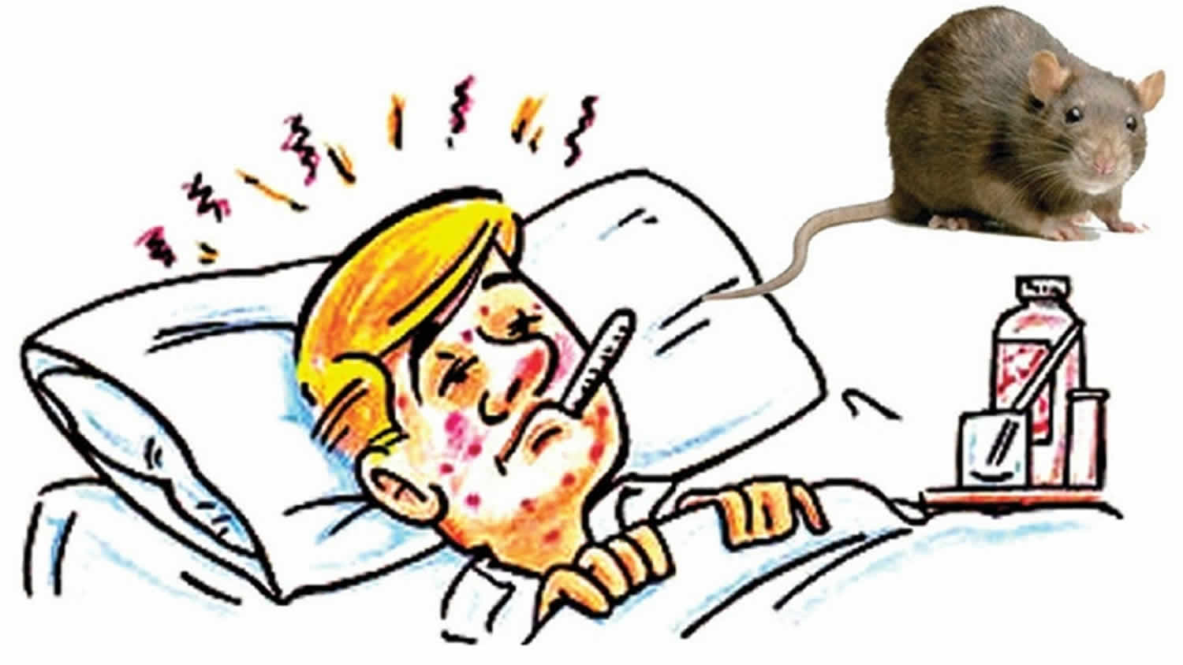

Slide 24
Leptospirosis
a bacterial disease affecting both humans and animals
caused by the bacteria, Leptospira interrogans
Avoid contact with water and soil contaminated by infected animals like rats.

Slide 25
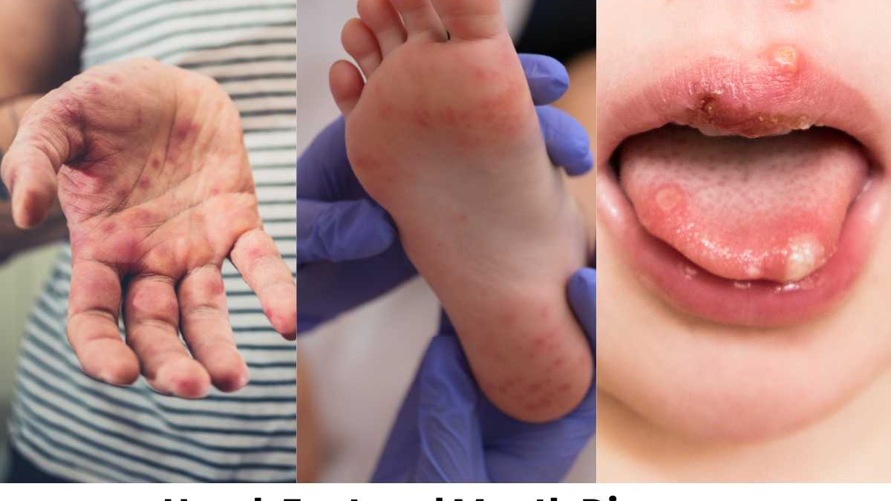

Slide 26
Hand, Foot, and Mouth Disease
a mild, contagious infection common among young enteroviruses
causes sores in or on the mouth, and on the hands and feet

Slide 27
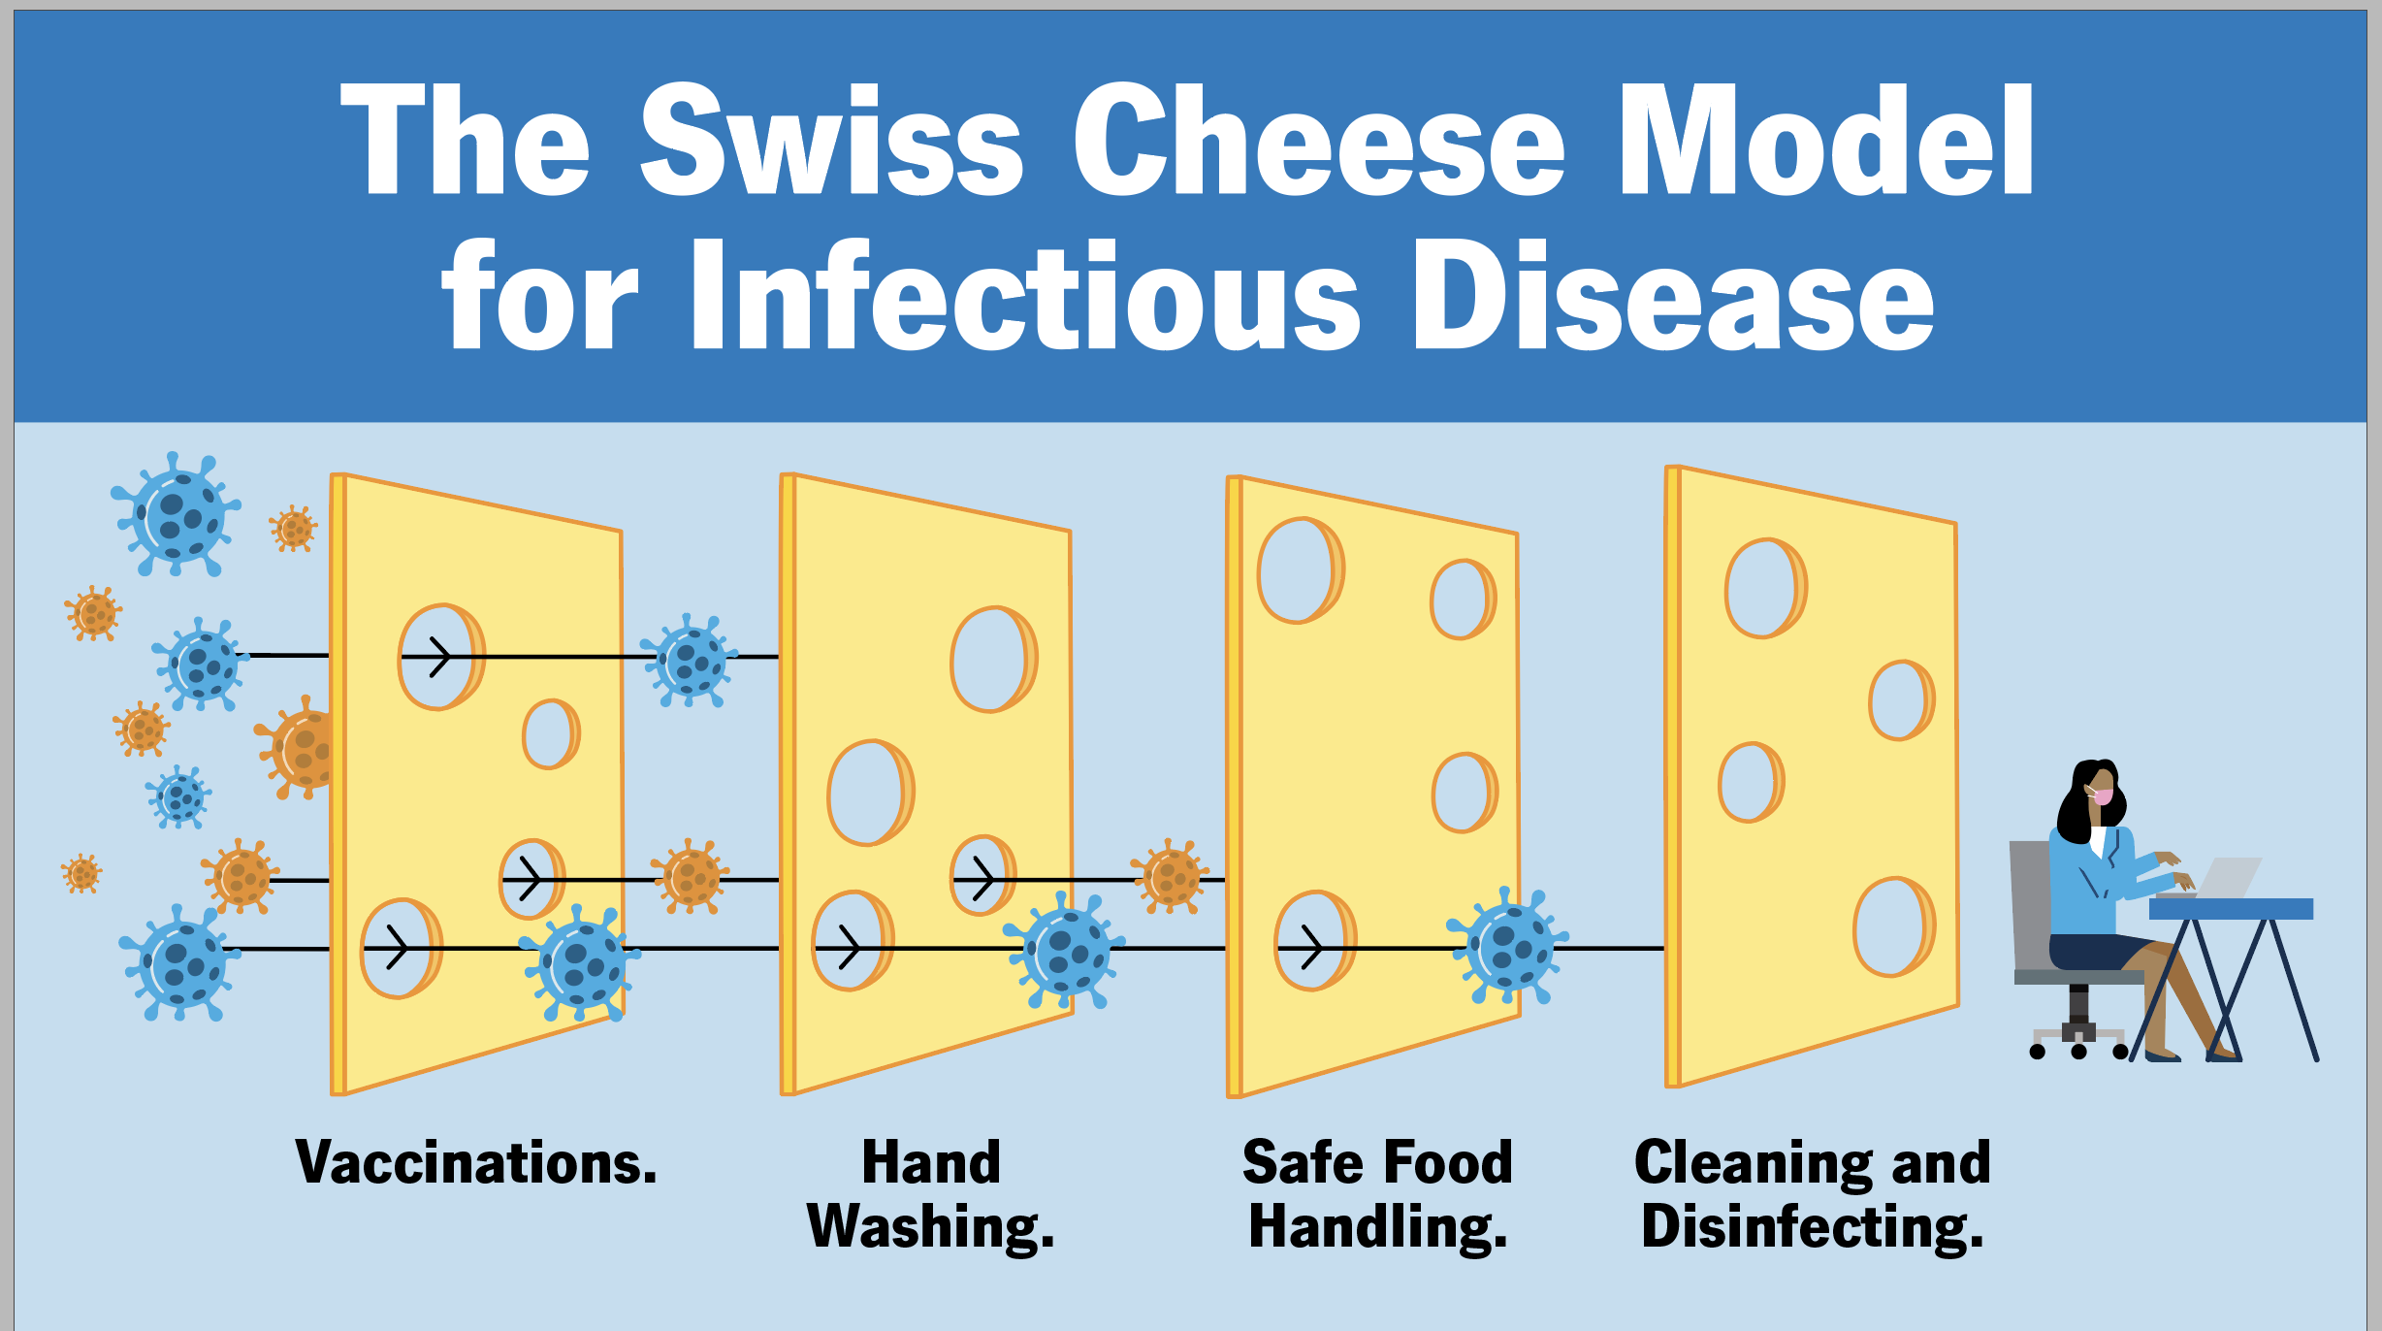

Slide 28

Performance Task in Health
On a 1/8 illustration board, create a campaign material to encourage people to practice safety protocols to avoid acquiring communicable diseases. Cover your output with plastic cover and do not forget to write your name and section at the back.
Criteria:
Creativity – 20
Content/Message – 20
Timeliness – 10

